Slide 1
Spotify End-to-End Data Pipeline

Slide 2
Azure Modern Data Stack Project
• Built a fully automated, production-ready pipeline
• From raw Spotify data → actionable insights
• Incremental loads, monitoring & alerts included

Slide 3
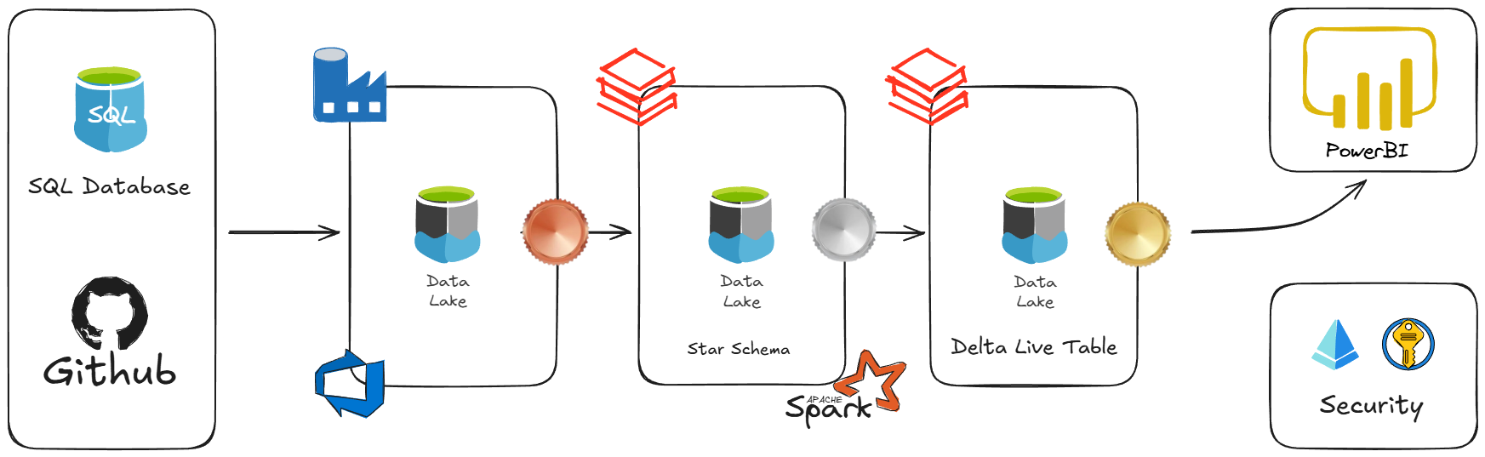
High-Level Architecture Medallion Architecture
(Bronze → Silver → Gold)
• GitHub → SQL DB → ADF → ADLS Gen2 → Databricks → Power BI

Slide 4
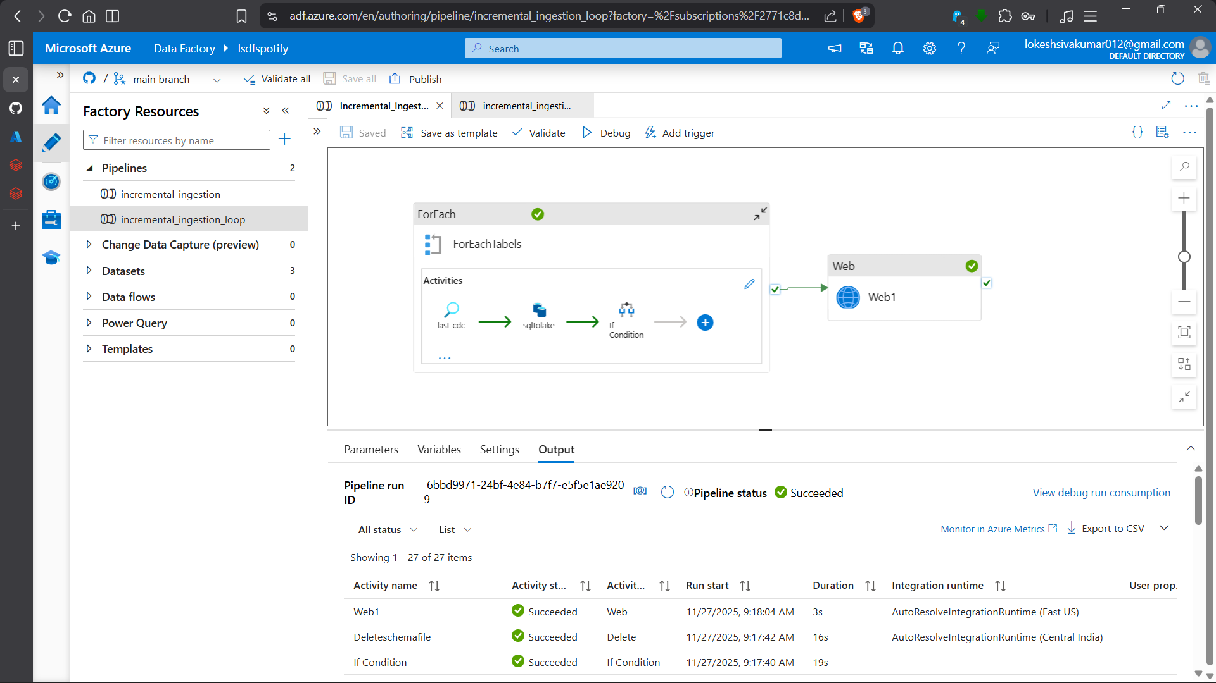
Ingestion – Azure Data Factory
• Incremental loading using CDC logic
• ForEach loop + parameters → works for any table
• Lookup → Copy → Update watermark → Delete temp files
• Scheduled with triggers

Slide 5
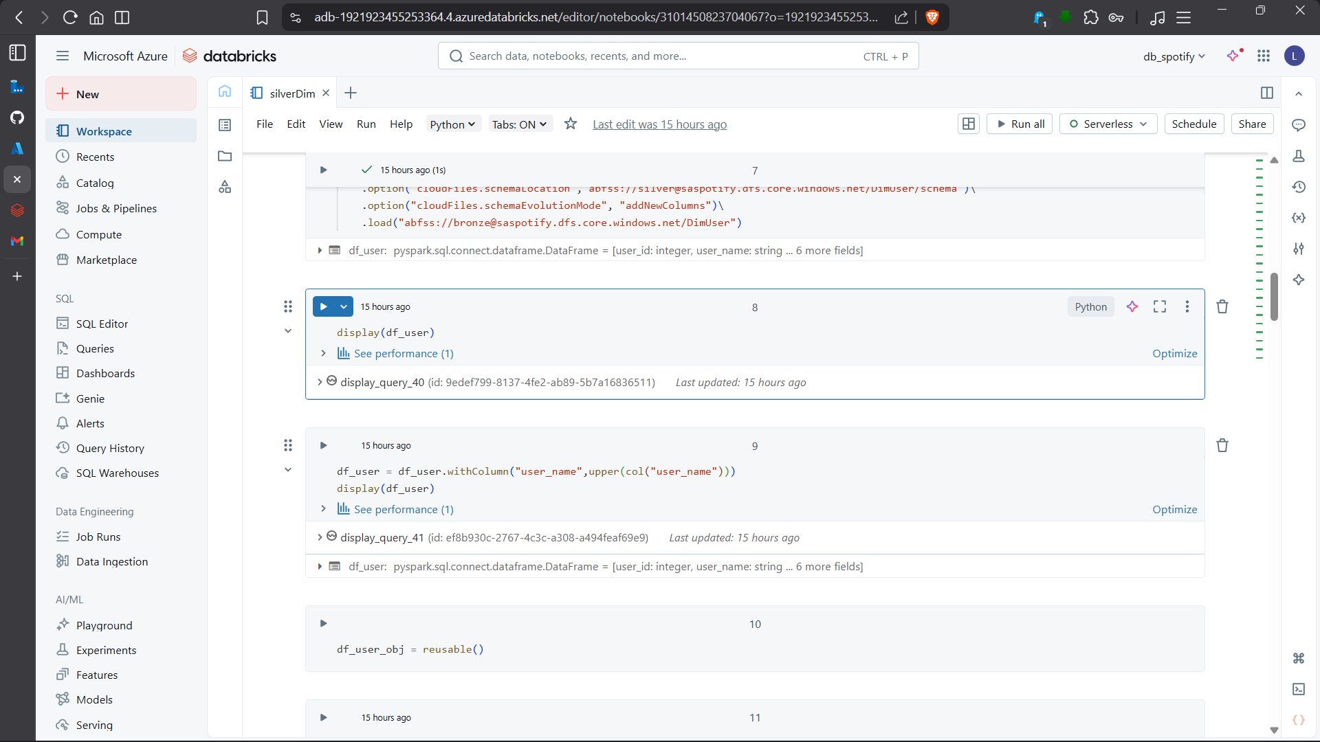
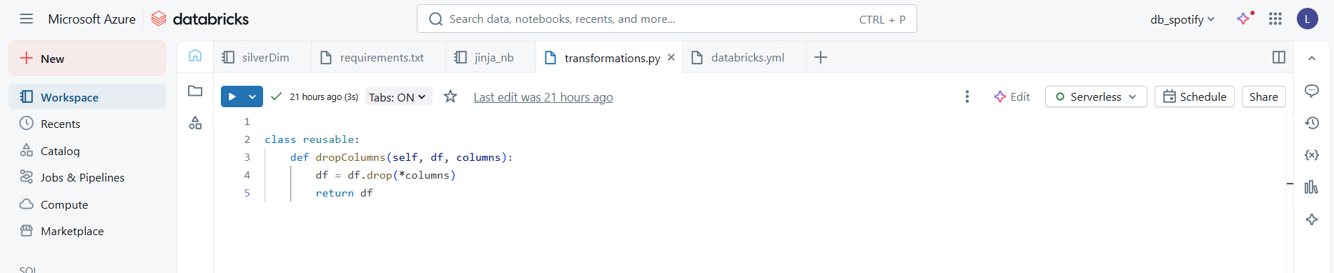
Transformation – Databricks
• PySpark + AutoLoader (streaming)
• Reusable Python class for cleaning
• Delta Tables for reliability
• Examples: uppercase names, deduplication, duration flags

Slide 6
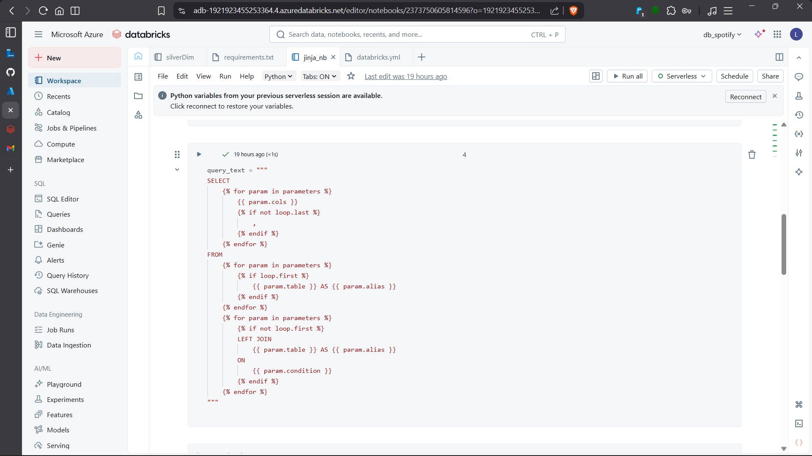
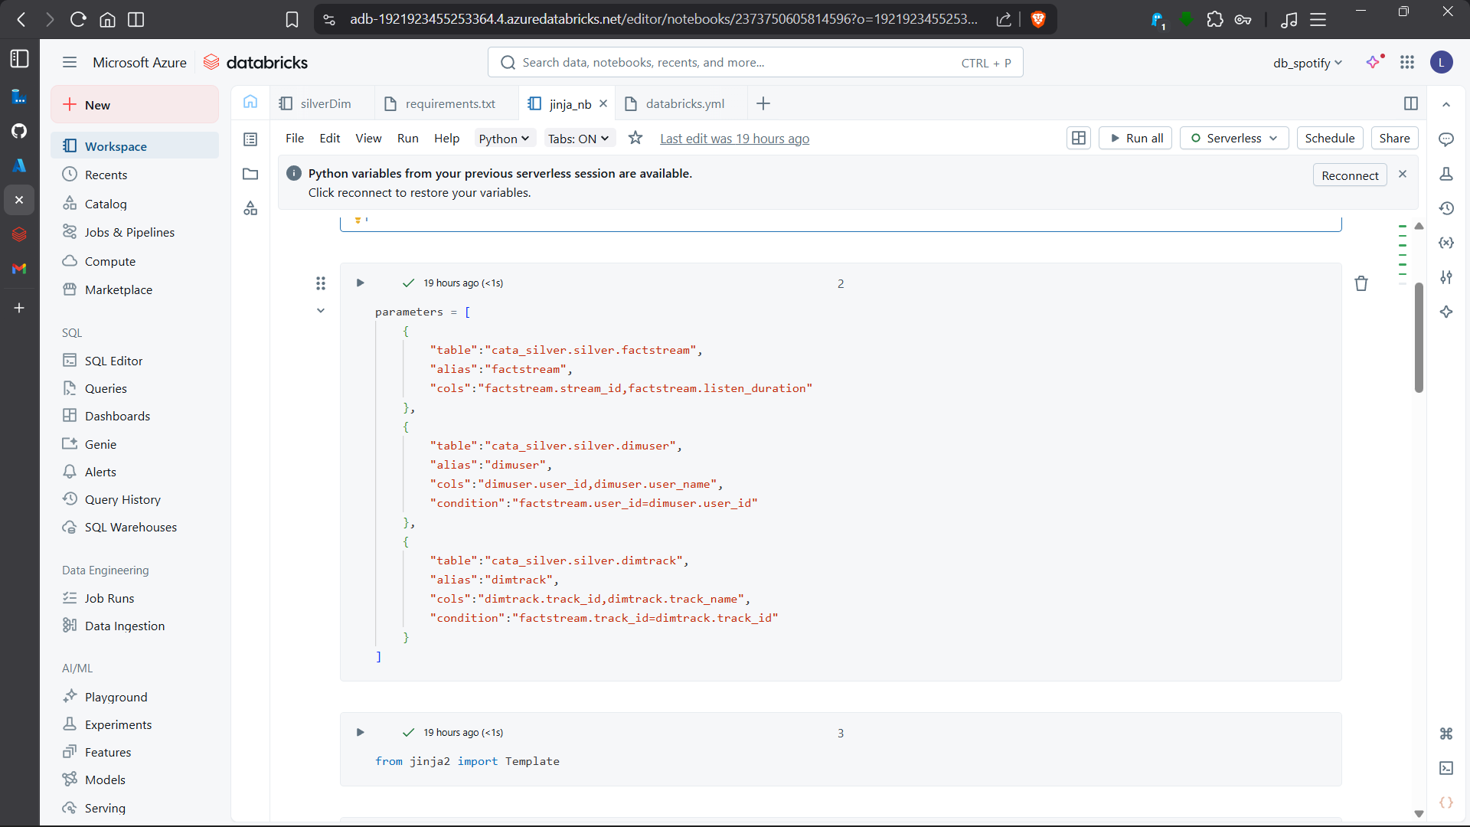
Advanced Features I Added
• Jinja2 templating → dynamic pipelines
• Databricks Asset Bundles → one-click deploy to prod
• Delta Live Tables (Gold layer) + SCD Type-2
• Monitoring → Logic App email alerts on failure

Slide 7
Challenges I Solved
• Large datasets → PySpark & Delta Lake
• Duplicates / bad data → deduplication + reusable class
• Schema changes → Delta Lake versioning
• Pipeline failures → instant email alerts

Slide 8
What I Gained (Ready for Your Team!)
Hands-on production experience with:
• Azure Data Factory
• Databricks
• Delta Lake
• ADF CI/CD
• Incremental ETL
• Monitoring & Alerts
• Dynamic pipelines
I can build and maintain scalable pipelines from Day 1
Any questions?
😊
Thank you!

